Slide 1

PINBOARD
A Real-Time Collaborative Infinite Corkboard Workspace
Bhaumik Jangid
Lovely Professional University
Major Project | B.Tech Computer Science | 2026-27
PinBoard | Major Project 2026–27

Slide 2
The Problem We Solved
Existing Tools Fall Short
Our Observation
The Gap
• Physical boards can't be shared remotely
• Digital tools (Notion, Trello) feel flat and clinical
• No real tactile, physical feel in productivity apps
• Real-time collaboration is complex to set up
• Teams need a shared visual workspace
• Remote work demands real-time sync
• Users want something physical and intuitive
• No tool combines infinite canvas + physical board
• No product merges skeuomorphic corkboard
• No infinite canvas + real-time collaboration
• No physics-inspired animations in board tools
• The perfect tool simply doesn't exist
"We built the digital equivalent of a physical team corkboard — alive, collaborative, and infinite."
PinBoard | Major Project 2025–26

Slide 3
What is PinBoard?
Interactive Digital Corkboard
Architecture
PinBoard is a full-stack production application featuring:
• Infinite digital corkboard workspace
• Create, pin, drag, and resize sticky notes
• Real-time multi-user collaboration via WebSocket
• Physics-inspired animations (pin pull, note fall)
• Board locked by 4 corner pins — remove all to pan
• Microservices architecture with Docker
Browser
NGINX Proxy :80
auth :3001
board :3002
realtime :3003
MongoDB
Redis
/api/auth/ → auth-service
/api/boards/ → board-service
/socket.io/ → realtime-service
3 Microservices · 7 Docker Containers · Socket.IO Real-time · JWT Auth
PinBoard | Major Project 2025–26

Slide 4
Technology Stack
Frontend
Backend
DevOps & Infrastructure
● React 19 + TypeScript
● Vite (build tool)
● Tailwind CSS
● Framer Motion (animations)
● Zustand (state management)
● react-rnd (drag & resize)
● Node.js + Express
● TypeScript (strict mode)
● Mongoose ODM
● Socket.IO 4.x
● JWT + bcryptjs
● ioredis
● Docker + Docker Compose
● NGINX (reverse proxy)
● Jenkins (CI/CD pipeline)
● MongoDB 7
● Redis 7
● GitHub
React · Node · MongoDB · Redis · Docker · Jenkins · NGINX
PinBoard | Major Project 2025–26

Slide 5
Core Features — The Board Experience
Interactive Pin System
Sticky Note System
• 4 metallic corner pins lock the board
• Click to pull out with spring animation
• Remove all 4 → board unlocks for panning
• Removed pins land in a 3D pin tray
• Re-insert any pin → board locks instantly
• Board stability % drops per removed pin
• 5 note types: Normal, Task, Reminder, Urgent, Idea
• 6 pastel colors with matching pin colors
• Drag anywhere on 3000×2000 canvas
• Resize from corners/edges
• Double-click to edit with handwriting font
• Folded corner effect, ruled lines, shadows
Infinite Canvas
Note Customization
• Smooth pan (mouse drag when unlocked)
• Pinch-to-zoom / scroll wheel zoom
• Zoom range: 20% to 300%
• Zoom dial shows live percentage
• Viewport position persisted to database
• Board wobble animation when pins removed
• Color picker in hover toolbar
• Duplicate note in one click
• Task notes with inline checklist
• Reminder notes with date/time picker
• Bring-to-front on click (z-index)
• Archive instead of hard delete
PinBoard | Major Project 2025–26

Slide 6
Core Features — Collaboration & Productivity
Real-Time Collaboration
Productivity Tools
Socket.IO WebSocket rooms per board
Any change syncs instantly to all users:
• Note created / moved / edited / deleted
• Board lock/unlock state
• Cursor positions
Collab modal with shareable board link
Live presence — collaborator avatars top-right
Live cursors with name chips
Join via URL: /board?id=BOARD_ID
No refresh needed — fully live
🔍 Search — full-text + filter by type/color, Cmd+K
📋 Templates — 4 presets: Brainstorm, Sprint Board, Study Planner, Retrospective
🗺️ Note Map — visual minimap of all notes, click to jump
🗂️ Archive — restore deleted notes from slide-in drawer
🔔 Reminders — browser notifications when due
🗑️ Clear Board — archive all notes with confirmation
📊 Board Stability — live widget showing stability %
PinBoard | Major Project 2025–26

Slide 7
Microservice Architecture
🔐 auth-service (Port 3001)
📋 board-service (Port 3002)
⚡ realtime-service (Port 3003)
Responsibilities:
• User registration & login
• JWT token generation
• Password hashing (bcryptjs)
• /health endpoint
• MongoDB: pinboard-auth
Responsibilities:
• Board CRUD operations
• Note CRUD + duplicate
• Position & z-index mgmt
• Full-text search & filter
• Archive, restore, viewport
Responsibilities:
• Socket.IO server
• Board rooms management
• Broadcasting note events
• Cursor position sync
• User presence & reconnect
POST /api/auth/register
POST /api/auth/login
GET /api/auth/me
POST /api/auth/logout
GET /api/boards/
POST /api/boards/:id/notes
PATCH /boards/:id/notes/pos
GET /api/boards/:id/search
emit board:join
emit note:created
emit note:moved
emit cursor:move
All 3 services communicate through NGINX. Inter-service auth uses shared JWT_SECRET — no network calls.
PinBoard | Major Project 2025–26

Slide 8
DevOps — Docker & Jenkins CI/CD
Docker Architecture
Jenkins Pipeline
Container | Image | Type
nginx | nginx:1.27-alpine | Docker Hub
frontend | pinboard/frontend | Custom Build
auth-service | pinboard/auth | Custom Build
board-service | pinboard/board | Custom Build
realtime-service | pinboard/realtime | Custom Build
mongo | mongo:7 | Docker Hub
redis | redis:7-alpine | Docker Hub
1. Checkout
2. Install
3. Typecheck
4. Build
7. Deploy
6. Docker Push
5. Docker Build
1. git checkout scm
2. npm ci — parallel across services
3. tsc --noEmit — strict validation
4. npm run build — Vite + tsc
5. docker build — 4 custom images
6. push to Docker Hub registry
7. docker compose up --build -d
4 Custom Images · 3 Docker Hub · Named Volumes · Health Checks
Single command to deploy entire stack: docker compose up --build -d
PinBoard | Major Project 2025–26

Slide 9
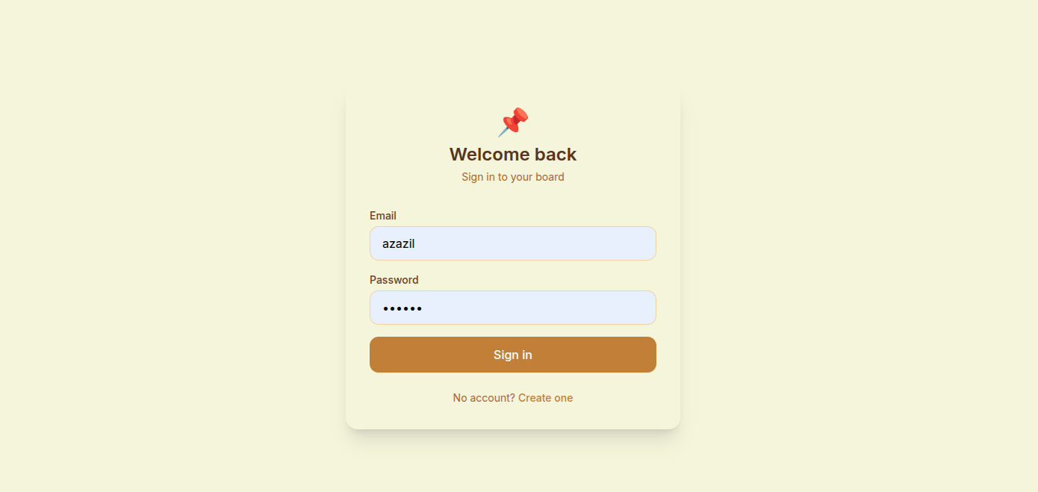
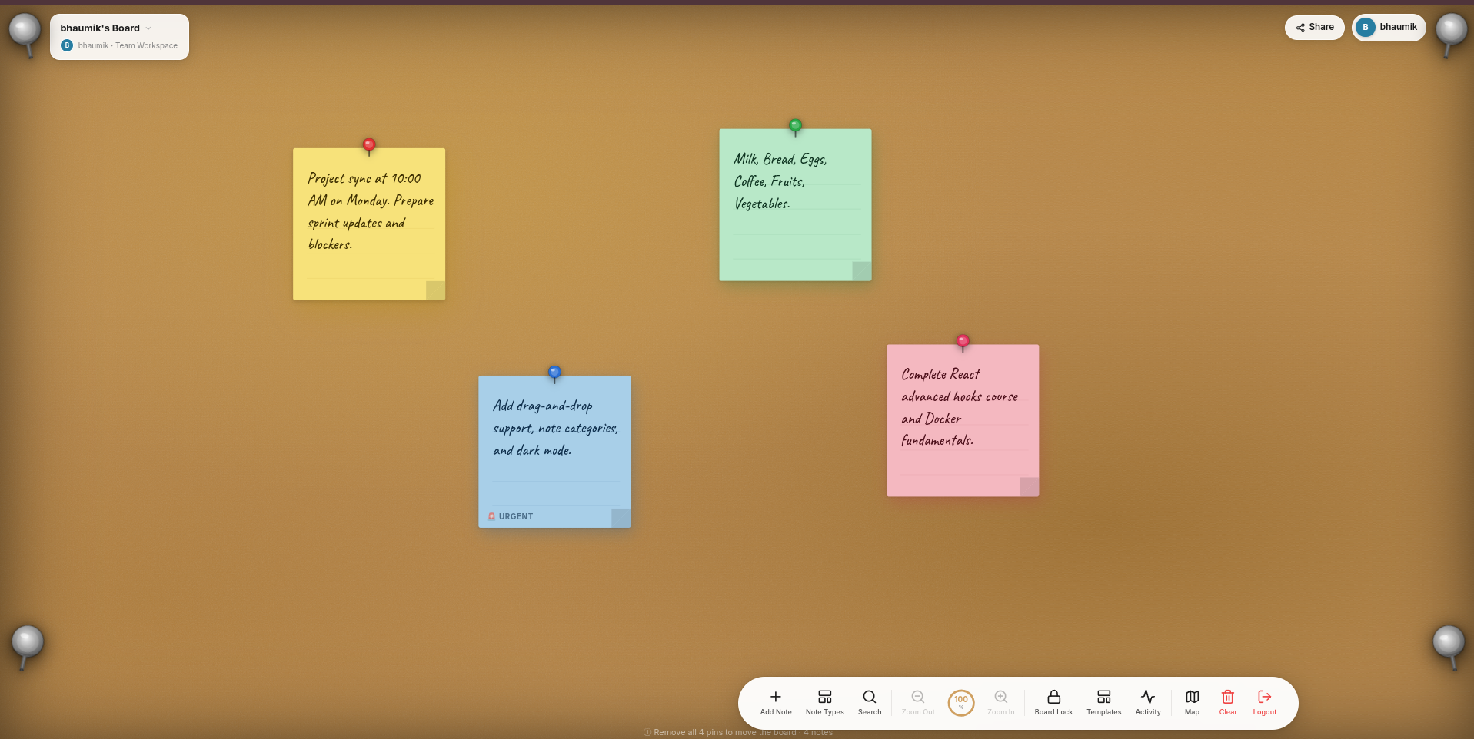
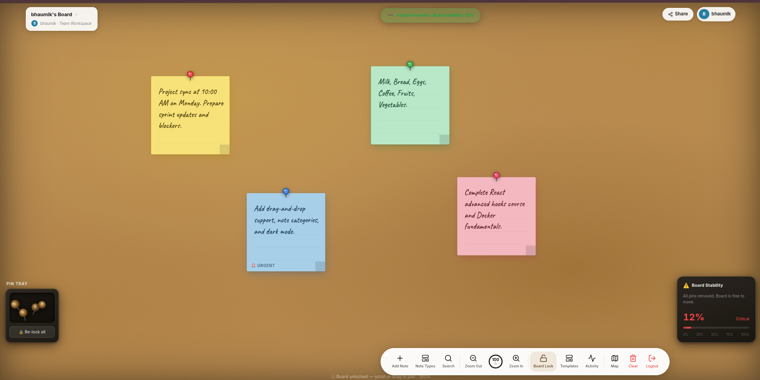
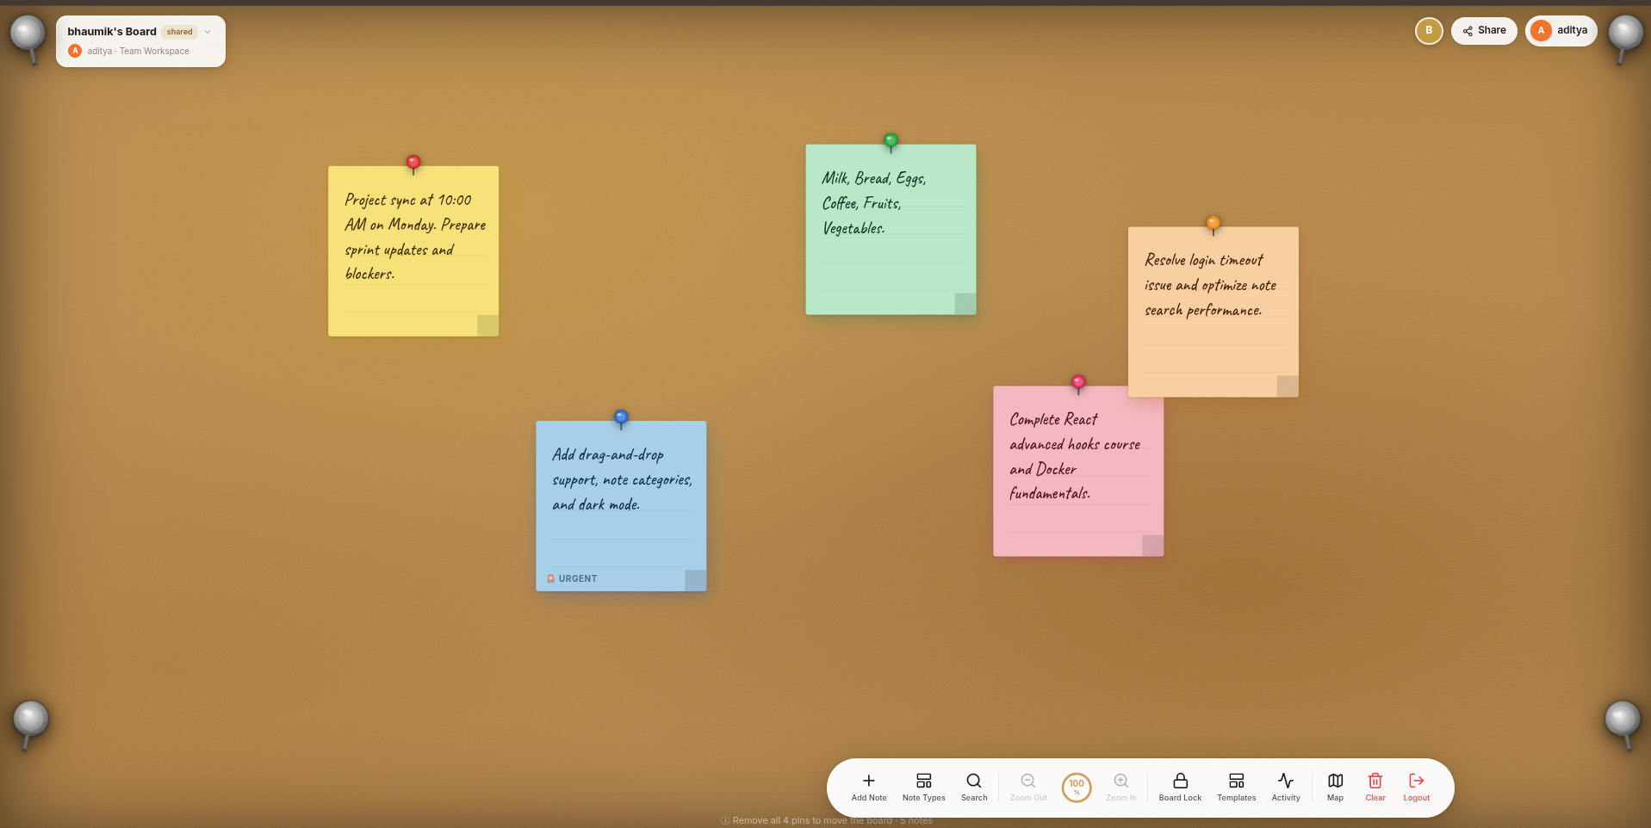
Results & Output
Login page — glassmorphism on cork background
Board with sticky notes — handwriting font, colored pins
Pin tray + Board Stability widget — 2 pins removed
Real-time collaboration — two users on same board
✅ 3 Microservices · ✅ 7 Docker Containers · ✅ <200ms Sync · ✅ JWT 7-Day · ✅ TypeScript Strict · ✅ NGINX Rate Limit
PinBoard | Major Project 2025–26

Slide 10
Future Scope & Conclusion
Future Enhancements
Conclusion
🔮 Phase 1 — Enhanced Collaboration
What We Built
Voice/video chat · Drawing tools (pen, shapes) · Version history · @mentions
A production-grade collaborative infinite corkboard — not a CRUD app, but a genuinely interactive product.
🔮 Phase 2 — AI Integration
AI note summarization · Auto-categorize & cluster · Smart reminders · Template from transcripts
Technologies Mastered
• Full MERN stack with TypeScript
• Microservices architecture
• Real-time WebSocket collaboration
• Docker containerization & CI/CD
• Advanced React animations
🔮 Phase 3 — Enterprise Features
Organization workspaces · Export to PDF/PNG/Miro · SSO (Google, GitHub) · Audit logs
🔮 Phase 4 — Mobile
React Native app · Offline-first with sync · Touch gestures for pinch zoom and drag
Final Outcome
PinBoard demonstrates that a college project can achieve production-quality software engineering.
✅ Academic Requirements Met
MERN Stack · 3+ Microservices · docker-compose · Custom Dockerfiles · Jenkins CI/CD
"Built to production standards. Designed for real teams. Deployed with Docker."
PinBoard | Major Project 2025–26

